Slide 1

Let’s Focus on Census Geography
Ed Christopher FHWA Resource Center Planning Team 4749 Lincoln Mall Dr Matteson, IL 60443 708-283-3534 edc@EdtheFed.com | Mike Ratcliffe Assistant Division Chief Products and Criteria Geography Division U.S. CB 4600 Silver Hill Road Washington, DC 20233 301-763-8977 michael.r.ratcliffe@census.gov | Joe Hausman HSP Coordination Manager FHWA, Room E83-447 1200 New Jersey Ave., SE Washington, DC 20590 Phone: 202-366-5047 joseph.hausman@dot.gov
Sunday, April 11, 2010
1:00 to 5:00 pm
http://www.edthefed.com/gist/

Slide 2
1:00 – 1:20 pm: Putting a Transportation Perspective on Census Geography, Ed Christopher, Federal Highway Administration
Census Geography Issues, Michael Ratcliffe, Census Bureau
1:21 – 2:05 pm Urban Areas
2:06 – 2:16 pm: Metro and Micropolitan Statistical Areas, Metropolitan Divisions, Combined Statistical Areas
2:17 – 2:32 pm: Public Use Microdata Areas
2:33 – 3:00 pm: Traffic Analysis Zones Update

Slide 3
3:21 – 3:36 pm: FHWA’s move to a Linear Referencing System for HPMS, Joseph Hausman, Federal Highway Administration
Census Geography Issues, Michael Ratcliffe, Census Bureau
3:37 – 4:07 pm: TIGER: The Road Ahead
4:08 – 4:18 pm: Census Statistical Areas Program
4:19 – 4:34 pm: From FIPS to ANSI
4:35 – 4:50 pm: Geographic Products for 2010
4:51 – 5:00 pm: Final Issues

Slide 4

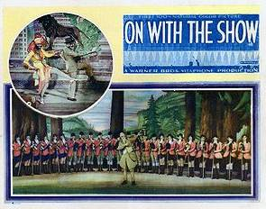
On with the Show! (1929) is historically important in cinema history as the first ever all talking-all color feature length movie. This was the second color movie released by Warner Bros.; the first was a partly color black and white musical, The Desert Song (1929).

